Slide 1


International Economics: Theory and Policy
Twelfth Edition
Chapter 13
National Income Accounting and the Balance of Payments
Copyright © 2022, 2018, 2015 Pearson Education, Inc. All Rights Reserved
Notes:
If this PowerPoint presentation contains mathematical equations, you may need to check that your computer has the following installed:
1) MathType Plugin
2) Math Player (free versions available)
3) NVDA Reader (free versions available)

Slide 2
Learning Objectives
13.1 Discuss concept of current account balance.
13.2 Use the current account balance to extend national income accounting to open economies.
13.3 Apply national income accounting to the interaction of saving, investment, and net exports.
13.4 Describe balance of payments accounts and explain their relationship to the current account balance.
13.5 Relate the current account to changes in a country’s net foreign wealth.

Slide 3
Preview
National income accounts
measures of national income
measures of value of production
measures of value of expenditure
National saving, investment, and the current account
Balance of payments accounts

Slide 4
The National Income Accounts (1 of 5)
Records the value of national income that results from production and expenditure.
Producers earn income from buyers who spend money on goods and services.
The amount of expenditure by buyers = the amount of income for sellers = the value of production.
National income is often defined to be the income earned by a nation’s factors of production.

Slide 5
The National Income Accounts (2 of 5)
Gross national product (G N P) is the value of all final goods and services produced by a nation’s factors of production in a given time period.
What are factors of production? Factors that are used to produce goods and services: workers (labor services), physical capital (such as buildings and equipment), natural resources, and others.
The value of final goods and services produced by U.S.-owned factors of production are counted as U.S. G N P.

Slide 6
The National Income Accounts (3 of 5)
G N P is calculated by adding the value of expenditure on final goods and services produced:
Consumption: expenditure by domestic consumers
Investment: expenditure by firms on buildings and equipment
Government purchases: expenditure by governments on goods and services
Current account balance (exports minus imports): net expenditure by foreigners on domestic goods and services

Slide 7
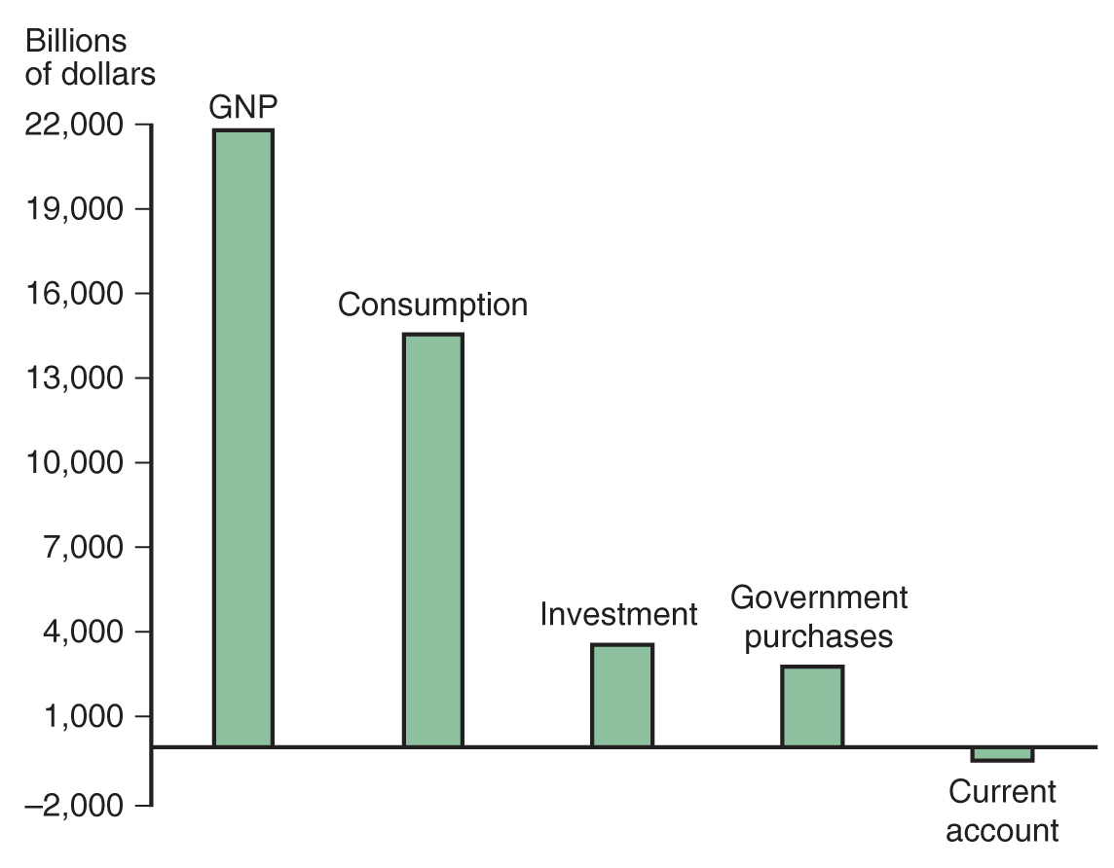
Figure 13.1 U.S. GNP and Its Components
America’s gross national product for the first quarter of 2020 can be broken down into the four components shown.
Source: U.S. Department of Commerce, Bureau of Economic Analysis. The figure shows 2016:Q I G N P and its components at an annual rate, seasonally adjusted.
Notes:
The bar graph plots billions of dollars versus U S G N P and its components. The following list provides amount in billions of dollars, by category. G N P, 22,000. consumption, 14,000. investment, 3,500. government purchases, 3,000. current account, negative 500. All values are estimated.

Slide 8
The National Income Accounts (4 of 5)
G N P is one measure of national income, but a more precise measure of national income is G N P adjusted for following:
Depreciation of physical capital results in a loss of income to capital owners, so the amount of depreciation is subtracted from G N P.
Unilateral transfers to and from other countries can change national income: payments of expatriate workers sent to their home countries, foreign aid, and pension payments sent to expatriate retirees.

Slide 9
The National Income Accounts (5 of 5)
Another approximate measure of national income is gross domestic product (G D P):
– Gross domestic product measures the final value of all goods and services that are produced within a country in a given time period.
from foreign countries for
factors of production + payments to foreign countries for factors of production

Slide 10
National Income Accounting for an Open Economy (1 of 2)
The national income identity for an open economy is
where C + I + G is expenditure by domestic individuals and institutions
and C A is net expenditure by foreign individuals and institutions

Slide 11
National Income Accounting for an Open Economy (2 of 2)
When production > domestic expenditure, exports > imports: current account > 0 and trade balance > 0
when a country exports more than it imports, it earns more income from exports than it spends on imports
net foreign wealth is increasing
When production < domestic expenditure, exports < imports: current account < 0 and trade balance < 0
when a country exports less than it imports, it earns less income from exports than it spends on imports
net foreign wealth is decreasing

Slide 12
Table 13.1 National Income Accounts for Agraria, an Open Economy (Bushels of Wheat)
G N P (total output) | = | Consumption | + | Investment | + | Government purchases | + | Exports | minus | Imports
100 | = | 75 to the a power | + | 25 | + | 10 | + | 10 | minus | 20 to the b power

Slide 13
Saving and the Current Account
National saving (S) = national income (Y) that is not spent on consumption (C) or government purchases (G).
An open economy can save by building up its capital stock or by acquiring foreign wealth.

Slide 14
Private and Government Saving
Private saving is the part of disposable income (national income, Y, minus taxes, T) that is saved rather than consumed:
Government saving is net tax revenue, T, minus government purchases, G:
Private and government saving add up to national saving.

Slide 15
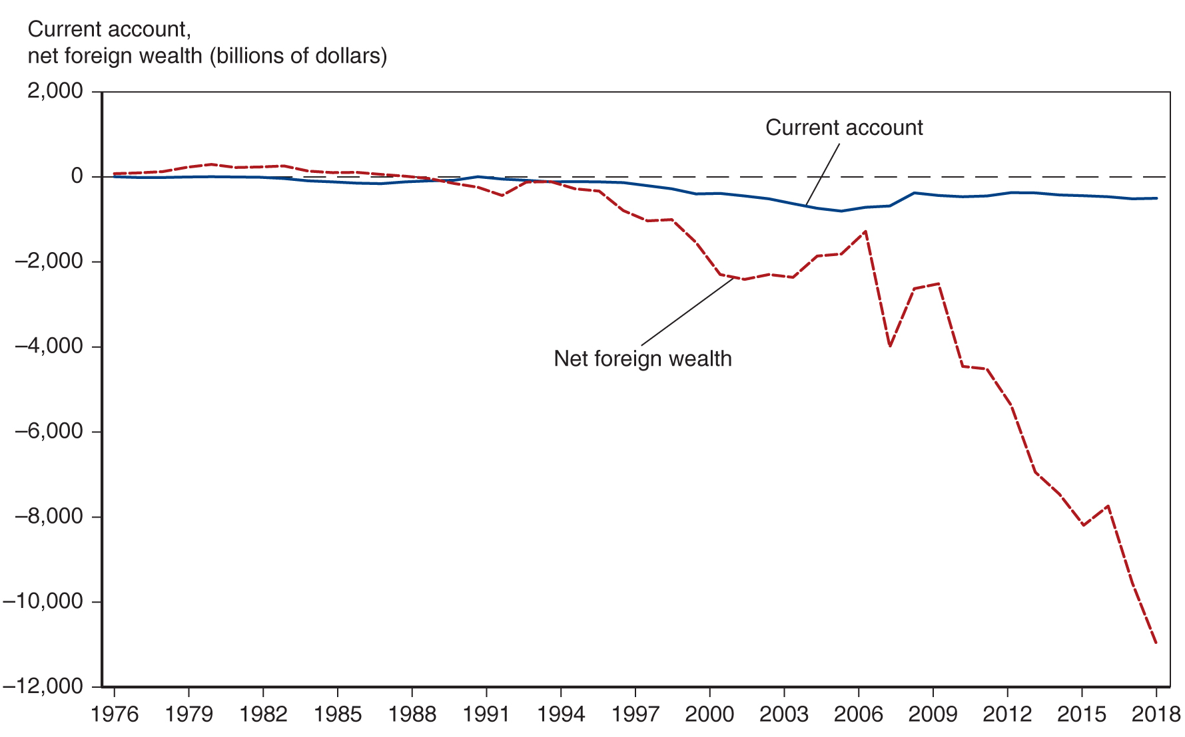
Figure 13.2 The U.S. Current Account and Net International Investment Position, 1976–2019
A string of current account deficits starting in the early 1980s reduced America’s net foreign wealth until, by the early 21st century, the country had accumulated a substantial net foreign debt.
Source: U.S. Department of Commerce, Bureau of Economic Analysis.
Notes:
The double line graph plots the U S current account and net foreign wealth in billions of dollars versus year, 19 76 to 20 18. The plot for current account generally falls from (19 76, 0) through (2004, negative 500) and then generally rises to (20 18, negative 400). The plot for net foreign wealth generally rises from (19 76, 0) to (19 80, 300) and then generally falls through (19 97, negative 1,000) to (2004, negative 2,200). The plot then rises to (2007, negative 1,200), falls to (2008, negative 4,000), rises again to (20 10, negative 2,500), and then falls to (20 18, negative 11,500). All values are estimated.

Slide 16
Balance of Payments Accounts (1 of 2)
A country’s balance of payments accounts for its payments to and its receipts from foreigners.
An international transaction involves two parties, and each
transaction enters the accounts twice: once as a credit (+)
and once as a debit

Slide 17
Balance of Payments Accounts (2 of 2)
The balance of payments accounts are separated into three broad accounts:
current account: accounts for flows of goods and services (imports and exports).
financial account: accounts for flows of financial assets (financial capital).
capital account: flows of special categories of assets (capital): typically non-market, non-produced, or intangible assets such as debt forgiveness, copyrights, and trademarks.

Slide 18
Examples of Balance of Payments Accounting (1 of 4)
You import a fax machine from Olivetti.
Olivetti deposits your check in a U.S. bank.
Fax machine purchase (Current account, U.S. good import) | negative $1000
Sale of bank deposit (Financial account, U.S. asset sale) | +$1000

Slide 19
Examples of Balance of Payments Accounting (2 of 4)
You buy lunch in France and pay by credit card.
French restaurant receives payment from your credit card company.
Meal purchase (Current account, U.S. service import) | negative $200
Sale of credit card claim (Financial account, U.S. asset sale) | +$200

Slide 20
Examples of Balance of Payments Accounting (3 of 4)
You buy a share of B P.
B P deposits the money in a U.S. bank.
Stock purchase (Financial account, U.S. asset purchase) | negative $95
Bank deposit (Financial account, U.S. asset sale) | +$95

Slide 21
Examples of Balance of Payments Accounting (4 of 4)
U.S. banks forgive a $5,000 debt owed by the government of Bygonia through debt restructuring.
U.S. banks who hold the debt thereby reduce the debt by crediting Bygonia’s bank accounts.
U.S. banks debt forgiveness (capital account, U.S. transfer payment) | negative $5,000
Reduction in bank’s claims on Bygonia (financial account, U.S. asset sale) | +$5,000

Slide 22
How Do the Balance of Payments Accounts Balance?
Due to the double entry of each transaction, the balance of payments accounts will balance by the following equation:
current account + financial account + capital account = 0

Slide 23
Balance of Payments Accounts (1 of 8)
The three broad accounts are more finely divided:
Current account: imports and exports
merchandise (goods like D V D s)
services (payments for legal services, shipping services, tourist meals, etc.)
income receipts (interest and dividend payments, earnings of firms and workers operating in foreign countries)

Slide 24
Balance of Payments Accounts (2 of 8)
Current account: net unilateral transfers
gifts (transfers) across countries that do not purchase a good or service nor serve as income for goods and services produced
Capital account: records special transfers of assets, but this is a minor account for the United States

Slide 25
Balance of Payments Accounts (3 of 8)
Financial account: the difference between sales of domestic assets to foreigners and purchases of foreign assets by domestic citizens.
Financial inflow
Foreigners loan to domestic citizens by buying domestic assets.
Domestic assets sold to foreigners are a credit (+) because the domestic economy acquires money during the transaction.
Financial outflow
Domestic citizens loan to foreigners by buying foreign assets.
Foreign assets purchased by domestic citizens are a debit
because the domestic economy gives up money during the transaction.

Slide 26
Balance of Payments Accounts (4 of 8)
Financial account has at least three subcategories:
Official (international) reserve assets
All other assets
Statistical discrepancy

Slide 27
Balance of Payments Accounts (5 of 8)
Statistical discrepancy
Data from a transaction may come from different sources that differ in coverage, accuracy, and timing.
The balance of payments accounts therefore seldom balance in practice.
The statistical discrepancy is the account added to or subtracted from the financial account to make it balance with the current account and capital account.

Slide 28
Balance of Payments Accounts (6 of 8)
An economy’s central bank is the institution responsible for managing the supply of money.
In the United States, the central bank is the Federal Reserve.
Central banks often buy or sell international reserves in private asset markets to affect macroeconomic conditions in their economies.
Official transactions of this type are called official foreign exchange intervention.
One reason why foreign exchange intervention can alter macroeconomic conditions is that it is a way for the central bank to inject money into the economy or withdraw it from circulation

Slide 29
Balance of Payments Accounts (7 of 8)
Official (international) reserve assets: foreign assets held by central banks to cushion against financial instability.
Assets include government bonds, currency, gold, and accounts at the International Monetary Fund.
Official reserve assets owned by (sold to) foreign central banks are a credit (+) because the domestic central bank can spend more money to cushion against instability.
Official reserve assets owned by (purchased by) the domestic
central bank are a debit
because the domestic central bank
can spend less money to cushion against instability.

Slide 30
Balance of Payments Accounts (8 of 8)
The negative value of the official reserve assets is called the official settlements balance or “balance of payments.”
It is the sum of the current account, the capital account, the non-reserve portion of the financial account, and the statistical discrepancy.
A negative official settlements balance may indicate that a country
is depleting its official international reserve assets, or
may be incurring large debts to foreign central banks so that the domestic central bank can spend a lot to protect against financial instability.

Slide 31
The Mystery of the Missing Deficit (1 of 1)
Because each country’s exports are other countries’ imports, the world’s current account balances must add up to zero. But they don’t.
In all but one year between 1980 and 2003, the sum of global current accounts was negative.
Partly due to incomplete reporting of international investment income?
Since 2004, the measured global current account has been positive.
Partly due to growing international trade in services?

Slide 32
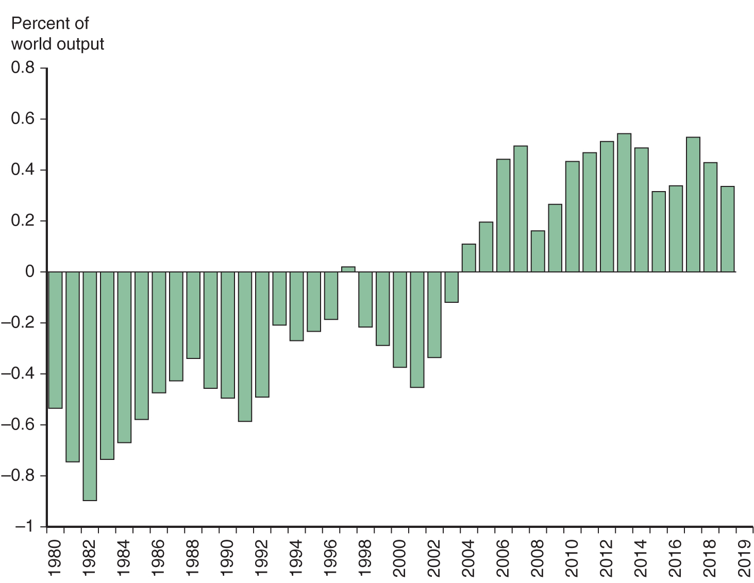
The Global Current Account Discrepancy Since 1980
Once big and negative, implying missing current account credits, the world’s current account balance has become big and positive, implying missing current account debits.
Source: International Monetary Fund, World Economic Outlook database, October 2019.
Notes:
The bar graph plots the global current account discrepancy since 19 80, with percent of world output versus year, 19 80 to 20 19. Between 19 80 and 2003, except for 19 97, the percent of world output is negative. 19 82, negative 0.9. 19 91, negative 0.65. 2003, negative 0.1. Between 2005 and 20 14, the world output is positive. 2005, 0.12. 20 10, 0.42. 20 16, 0.36. 20 19, 0.35. All values are estimated.

Slide 33
Table 13.2 U.S. Balance of Payments Accounts for 2019 (Billions of Dollars) (1 of 2)
Current Account | Blank | Blank
(1) | Exports and current transfer receipts Of which: | 3,805.94
 | Goods | 1,652.44
 | Services | 875.83
 | Income receipts (primary income) | 1,135.69
 | Current transfer receipts (secondary income) | 141.98
(2) | Imports and current transfer payments Of which: | 4,286.16
 | Goods | 2,516.77
 | Services | 588.36
 | Income receipts (primary income) | 899.35
 | Current transfer receipts (secondary income) | 281.69
 | Balance on current account left bracket left parenthesis 1 right parenthesis minus left parenthesis 2 right parenthesis right bracket | negative 480.22
(3) | Capital Account | negative 6.24
Source: U.S. Department of Commerce, Bureau of Economic Analysis, June 196, 2020, release. Totals may differ from sums because of rounding.

Slide 34
Table 13.2 U.S. Balance of Payments Accounts for 2019 (Billions of Dollars) (2 of 2)
Financial Account | Blank | Blank
(4) | Net U.S. acquisition of financial assets, excluding financial derivatives Of which: | 440.75
Blank | Official reserve assets | 4.66
Blank | Other assets | 436.09
(5) | Net U.S. incurrence of liabilities, excluding financial derivatives Of which: | 797.96
Blank | Official reserve assets | 61.63
Blank | Other assets | 736.33
(6) | Financial derivatives, other than reserves, net | negative 38.34
Blank | Net financial flows Left bracket left parenthesis 4 right parenthesis minus left parenthesis 5 right parenthesis minus left parenthesis 6 right parenthesis right bracket | negative 395.54
Statistical Discrepancy | Blank | 90.92
Blank | [Net financial flows less sum of current and capital accounts] | Blank
Source: U.S. Department of Commerce, Bureau of Economic Analysis, June 196, 2020, release. Totals may differ from sums because of rounding.

Slide 35
Multinationals’ Profit Shifting and Ireland’s Volatile GDP
Ireland’s G D P rose by a whopping 26.3% between 2014 and 2015, an outlier compared to growth rates since 1999.
No massive increase in factors of production such as employment occurred.
In large part, was an accounting phenomenon reflecting tax avoidance by large multinationals from other countries.
Ireland’s comparatively low corporate tax rate of 12.5% leads to multinationals allocating their intellectual property (I P) assets to Ireland (and other low-tax havens such as Bermuda).
G D P has shortcomings as a measure of economic welfare.

Slide 36
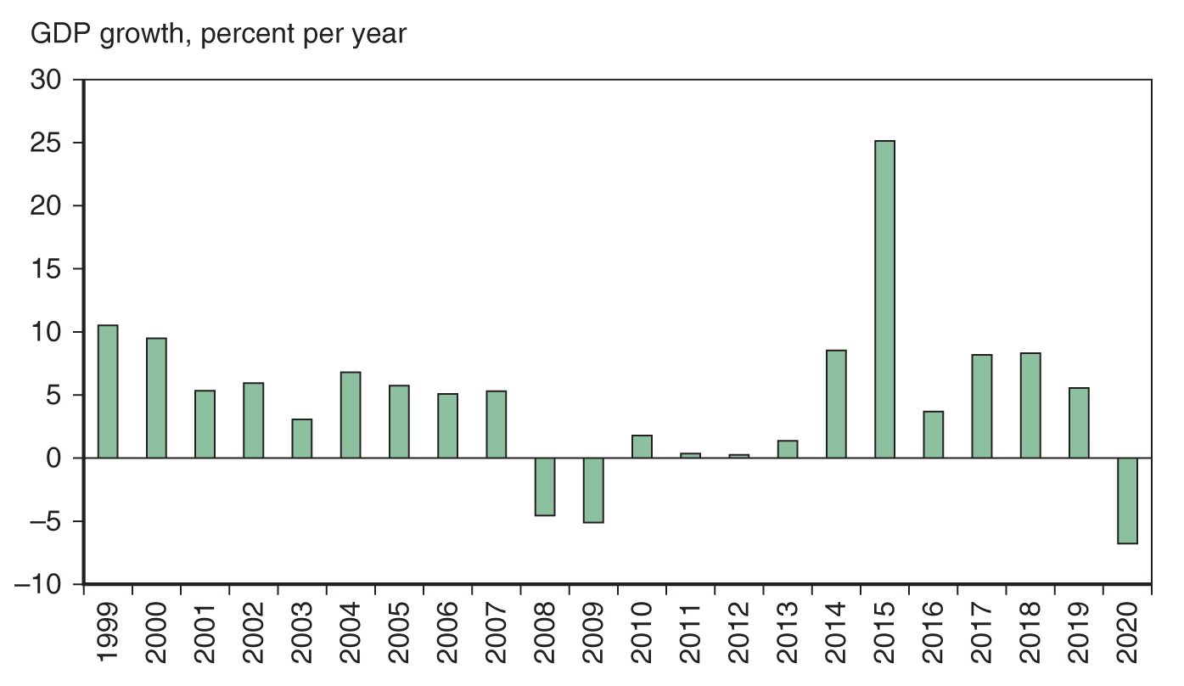
Real G D P Growth in Ireland Since 1999
The huge jump in Ireland’s 2015 real G D P was mostly an artifact of creative accounting.
Source: International Monetary Fund, World Economic Outlook database, April 2019. Data point for 2020 is a projection
Notes:
The bar graph plots the G D P growth, with percent per year versus year, 19 99 to 20 20. Between 2007 and 20 10 and in 20 20, the percent of G D P is negative. 2007, negative 5. 20 09, negative 6. 20 20, negative 7. Between 19 99 and 20 19, the percent of G D P is positive. 19 99, 10. 2003, 2.5. 20 10, 2. 20 15, 26. 20 19, 6. All values are estimated.

Slide 37
U.S. Balance of Payments Accounts (1 of 2)
The United States has the most negative net foreign wealth in the world, and so is therefore the world’s largest debtor nation.
Its current account deficit in 2012 was $440 billion dollars, so that net foreign wealth continues to decrease.
The value of foreign assets held by the United States has grown since 1980, but liabilities of the United States (debt held by foreigners) have grown faster.

Slide 38
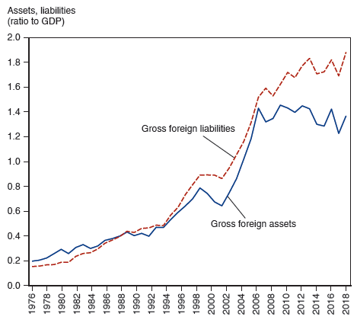
Figure 13.3 U.S. Gross Foreign Assets and Liabilities, 1976–2019
Since 1976, both the foreign assets and the liabilities of the United States have increased sharply. But liabilities have risen more quickly, leaving the United States with a substantial net foreign debt.
Source: U.S. Department of Commerce, Bureau of Economic Analysis.
Notes:
The double line graph plots gross foreign assets, and gross foreign liabilities, for the U S, with assets and liabilities as a ratio to G N P versus year, 19 76 to 20 19. The plot for gross foreign assets generally rises from (19 76, 0.2) through (19 89, 0.41), (2002, 0.62), (20 14, 1.4) to (20 18, 1.38). The plot for gross foreign liabilities generally rises from (19 76, 0.15) through (19 89, 0.41), (2002, 0.85), (20 13, 1.7) to (20 18, 1.9). All values are estimated.

Slide 39
U.S. Balance of Payments Accounts (2 of 2)
About 70% of foreign assets held by the United States are denominated in foreign currencies and almost all of U.S. liabilities (debt) are denominated in dollars.
Changes in the exchange rate influence value of net foreign wealth (gross foreign assets minus gross foreign liabilities).
Appreciation of the value of foreign currencies makes foreign assets held by the United States more valuable, but does not change the dollar value of dollar-denominated debt for the United States

Slide 40
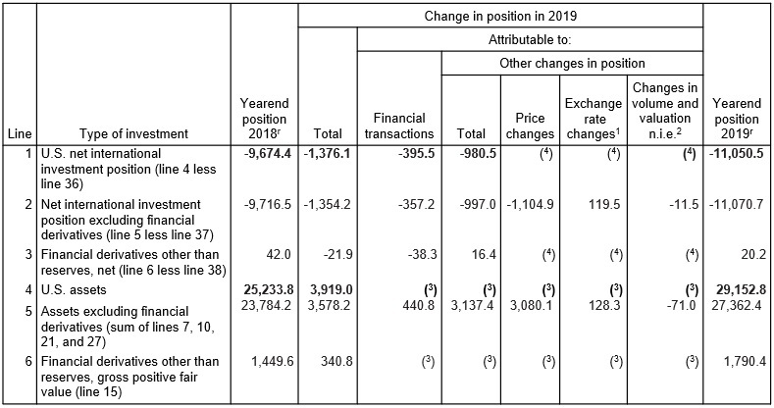
Table 13.3 Change in the Yearend U.S. Net International Investment Position (Billions of Dollars) (1 of 8)
Notes:
The columns have the following headings from left to right. Line, Type of investment, Yearend position 20 18 super r, Change in position in 20 19, total, Change in position in 20 19, attributable to, financial transactions, Change in position in 20 19, attributable to, other changes in position, total, Change in position in 20 19, attributable to, other changes in position, price changes, Change in position in 20 19, attributable to, other changes in position, exchange rate changes super 1 , Change in position in 20 19, attributable to, other changes in position, changes in volume and valuation n i e super 2, Yearend position, 20 19 super r. The row entries are as follows. Row 1. 1, U S net international investment position, line 4 less line 36, Negative 9,674.4 Negative 1,376.1 Negative 395.5, Negative 980.5 left parenthesis 4 right parenthesis, left parenthesis 4 right parenthesis, left parenthesis 4 right parenthesis, Negative 11,050.5. Row 2. 2, Net international investment position excluding financial derivatives, line 5 less line 37, Negative 9,716.5 Negative 1,354.2 Negative 357.2, Negative 997.0 Negative 1,104.9, 119.5, Negative 11,070.7. Row 3. 3, Financial derivatives other than reserves, net, line 6 less line 38, 42, Negative 21.9, Negative 38.3, 16.4, left parenthesis 4 right parenthesis, left parenthesis 4 right parenthesis, left parenthesis 4 right parenthesis, 20.2. Row 4. 4, U S assets 25233.8, 3919, left parenthesis 3 right parenthesis, left parenthesis 3 right parenthesis, left parenthesis 3 right parenthesis, left parenthesis 3 right parenthesis, left parenthesis 3 right parenthesis, 29,152.8. Row 5. 5, Assets excluding financial derivatives, sum of lines 7, 10, 21, and 27, 23784.2, 3578.2, 440.8, 3,137.4, 3,080.1, 128.3, Negative 71.0, 27,362.4. Row 6. 6, Financial derivatives other than reserves, gross positive fair value, line 15., 1449.6, 340.8, left parenthesis 3 right parenthesis, left parenthesis 3 right parenthesis, left parenthesis 3 right parenthesis, left parenthesis 3 right parenthesis, left parenthesis 3 right parenthesis, 1,790.4. Continued

Slide 41
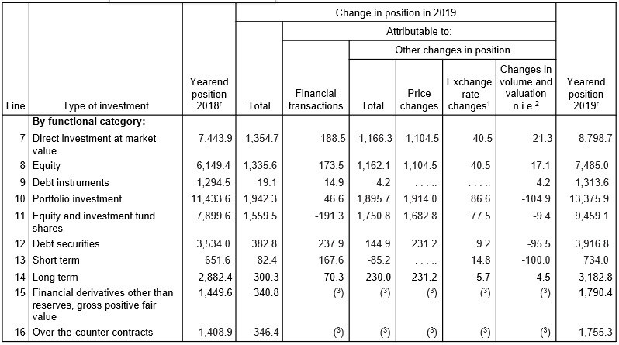
Table 13.3 Change in the Yearend U.S. Net International Investment Position (Billions of Dollars) (2 of 8)
Notes:
Continuation of the table. The columns have the following headings from left to right. Line, Type of investment, Yearend position 20 18 super r, Change in position in 20 19, total, Change in position in 20 19, attributable to, financial transactions, Change in position in 20 19, attributable to, other changes in position, total, Change in position in 20 19, attributable to, other changes in position, price changes, Change in position in 20 19, attributable to, other changes in position, exchange rate changes super 1 , Change in position in 20 19, attributable to, other changes in position, changes in volume and valuation n i e super 2, Yearend position, 20 19 super r. The row entries are as follows. Row 1. Blank, By functional category, Blank, Blank, Blank, Blank, Blank, Blank, Blank, Blank. Row 2. 7, Direct investment at market value, 7443.9, 1354.7, 188.5, 1,166.3, 1,104.5, 40 5, 21.3, 8,798.7. Row 3. 8, Equity, 6149.4, 1335.6, 173.5, 1,162.1, 1,104.5, 40.5, 17.1, 7,485.0. Row 4. 9, Debt instruments, 1294.5, 19.1, 14.9, 4.2, Nil, Nil, 4.2, 1,313.6. Row 5. 10, Portfolio investment, 11433.6, 1942.3, 46.6, 1,895.7, 1,914.0, 86.6, Negative 104.9, 13,375.9. Row 6. 11, Equity and investment fund shares, 7899.6, 1559.5, Negative 191.3, 1,750.8, 1,682.8, 77.5, Negative 9.4, 9,459.1. Row 7. 12, Debt securities, 3534, 382.8, 237.9, 144.9, 231.2, 9.2, Negative 95.5, 3,916.8. Row 8. 13, Short term, 651.6, 82.4, 167.6, Negative 85.2.Nil, 14.8, Negative 100.0, 734.0. Row 9. 14, Long term, 2882.4, 300.3, 70.3, 230.0, 231.2, Negative 5.7, 4.5, 3,182.8. Row 10. 15, Financial derivatives other than reserves, gross positive fair value, 1449.6, 340.8, left parenthesis 3 right parenthesis, left parenthesis 3 right parenthesis, left parenthesis 3 right parenthesis, left parenthesis 3 right parenthesis, left parenthesis 3 right parenthesis, 1,790.4. Row 11. 16, Over the counter contracts, 1,408.9, 346.4, left parenthesis 3 right parenthesis, left parenthesis 3 right parenthesis, left parenthesis 3 right parenthesis, left parenthesis 3 right parenthesis, left parenthesis 3 right parenthesis, 1,755.3. Continued.

Slide 42
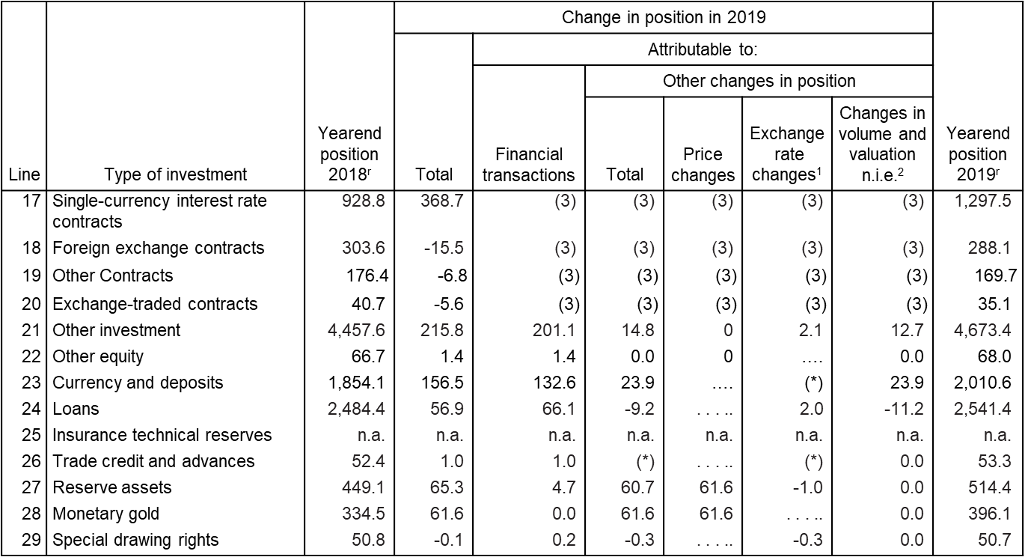
Table 13.3 Change in the Yearend U.S. Net International Investment Position (Billions of Dollars) (3 of 8)
Notes:
Continuation of the table. The columns have the following headings from left to right. Line, Type of investment, Yearend position 20 18 super r, Change in position in 20 19, total, Change in position in 20 19, attributable to, financial transactions, Change in position in 20 19, attributable to, other changes in position, total, Change in position in 20 19, attributable to, other changes in position, price changes, Change in position in 20 19, attributable to, other changes in position, exchange rate changes super 1 , Change in position in 20 19, attributable to, other changes in position, changes in volume and valuation n i e super 2, Yearend position, 20 19 super r. The row entries are as follows. Row 1. 17, Single currency interest rate contracts, 928.8, 368.7, Left parenthesis 3 right parenthesis, Left parenthesis 3 right parenthesis, Left parenthesis 3 right parenthesis, Left parenthesis 3 right parenthesis, Left parenthesis 3 right parenthesis, 1297.5. Row 2. 18, Foreign exchange contracts, 303.6, Negative 15.5, Left parenthesis 3 right parenthesis, Left parenthesis 3 right parenthesis, Left parenthesis 3 right parenthesis, Left parenthesis 3 right parenthesis, Left parenthesis 3 right parenthesis, 288.1. Row 3. 19, Other Contracts, 176.4, Negative 6.8, Left parenthesis 3 right parenthesis, Left parenthesis 3 right parenthesis, Left parenthesis 3 right parenthesis, Left parenthesis 3 right parenthesis, Left parenthesis 3 right parenthesis, 169.7. Row 4. 20, Exchange traded contracts, 40.7, Negative 5.6, Left parenthesis 3 right parenthesis, Left parenthesis 3 right parenthesis, Left parenthesis 3 right parenthesis, Left parenthesis 3 right parenthesis, Left parenthesis 3 right parenthesis, 35.1. Row 5. 21, Other investment, 4457.6, 215.8, 201.1, 14.8, 0, 2.1, 12.7, 4,673.4. Row 6. 22, Other equity, 66.7, 1.4, 1.4, 0.0, 0, Nil, 0.0, 68.0. Row 7. 23, Currency and deposits, 1854.1, 156.5, 132.6, 23.9, Nil, Left parenthesis asterisk right parenthesis, 23.9, 2,010.6. Row 8. 24, Loans, 2484.4, 56.9, 66.1, Negative 9.2, Nil, 2.0, Negative 11.2, 2,541.4. Row 9. 25, Insurance technical reserves, N A, N A, N A, N A, N A, N A, N A, N A. Row 10. 26, Trade credit and advances, 52.4, 1, 1.0, left parenthesis asterisk right parenthesis, Nil, Left parenthesis asterisk right parenthesis, 0.0, 53.3. Row 11. 27, Reserve assets, 449.1, 65.3, 4.7, 60.7, 61.6, Negative 1.0, 0.0, 514.4. Row 12. 28, Monetary gold, 334.5, 61.6, 0.0, 61.6, 61.6, Nil, 0.0, 396.1. Row 13. 29, Special drawing rights, 50.8, Negative 0.1, 0.2, Negative 0.3, Blank, Negative 0.3, 0.0, 50.7. Continued.

Slide 43
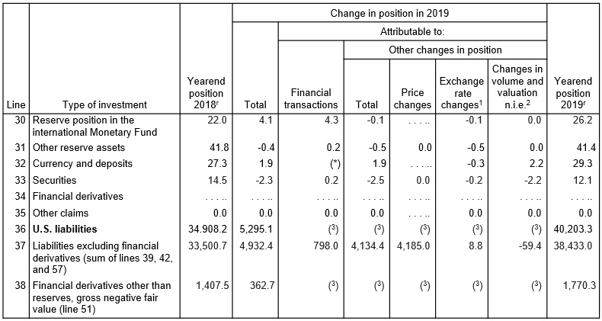
Table 13.3 Change in the Yearend U.S. Net International Investment Position (Billions of Dollars) (4 of 8)
Notes:
Continuation of the table. The columns have the following headings from left to right. Line, Type of investment, Yearend position 20 18 super r, Change in position in 20 19, total, Change in position in 20 19, attributable to, financial transactions, Change in position in 20 19, attributable to, other changes in position, total, Change in position in 20 19, attributable to, other changes in position, price changes, Change in position in 20 19, attributable to, other changes in position, exchange rate changes super 1 , Change in position in 20 19, attributable to, other changes in position, changes in volume and valuation n i e super 2, Yearend position, 20 19 super r. The row entries are as follows. Row 1. 30, Reserve position in the monetary fund, 22, 4.1, 4.3, Negative 0.1, Nil, Negative 0.1, 0, 26.2. Row 2. 31, Other reserve assets, 41.8, Negative 0.4, 0.2, Negative 0.5, 0.0, Negative 0.5, 0.0, 41.4. Row 3. 32, Currency and deposits, 27.3, 1.9, Left parenthesis asterisk right parenthesis 1.9, Nil, Negative 0.3, 2.2, 29.3. Row 4. 33, Securities, 14.5, Negative 2.3, 0.2, Negative 2.5, 0.0, Negative 0.2, Negative 2.2, 12.1. Row 5. 34, Financial derivatives, Nil, Nil, Nil, Nil, Nil, Nil, Nil, Nil. Row 6. 35, Other claims, 0, 0, 0.0, 0.0, Nil, 0.0, 0.0, 0.0. Row 7. 36, U S liabilities, 34908.2, 5295.1, Left parenthesis 3 right parenthesis Left parenthesis 3 right parenthesis Left parenthesis 3 right parenthesis Left parenthesis 3 right parenthesis Left parenthesis 3 right parenthesis 40,203.3. Row 8. 37, Liabilities excluding financial derivatives, sum of lines 39, 42, and 57, 33500.7, 4932.4, 798.0, 4,134.4, 4,185.0, 8.8, Negative 59.4, 38,433.0. Row 9. 38, Financial derivatives other than reserves, gross negative fair value, line 51, 1407.5, 362.7, Left parenthesis 3 right parenthesis Left parenthesis 3 right parenthesis Left parenthesis 3 right parenthesis Left parenthesis 3 right parenthesis Left parenthesis 3 right parenthesis 1,770.3. Continued

Slide 44
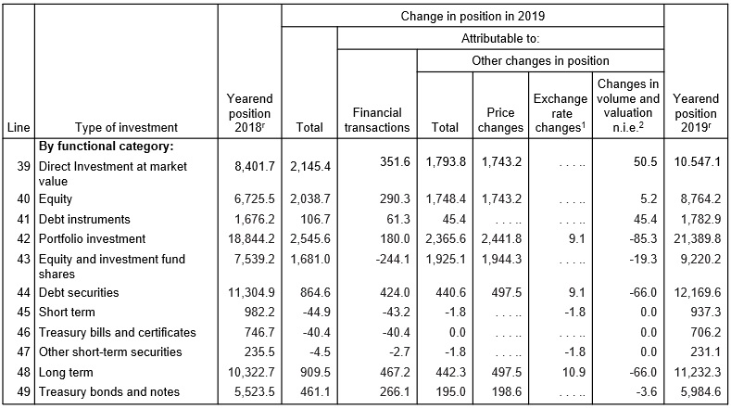
Table 13.3 Change in the Yearend U.S. Net International Investment Position (Billions of Dollars) (5 of 8)
Notes:
Continuation of the table. The columns have the following headings from left to right. Line, Type of investment, Yearend position 20 18 super r, Change in position in 20 19, total, Change in position in 20 19, attributable to, financial transactions, Change in position in 20 19, attributable to, other changes in position, total, Change in position in 20 19, attributable to, other changes in position, price changes, Change in position in 20 19, attributable to, other changes in position, exchange rate changes super 1 , Change in position in 20 19, attributable to, other changes in position, changes in volume and valuation n i e super 2, Yearend position, 20 19 super r. The row entries are as follows. Row 1. Blank, By functional category, Blank, Blank, Blank, Blank, Blank, Blank, Blank, Blank. Row 2. 39, Direct Investment at market value, 8401.7, 2145.4, 351.6, 1,793.8, 1,743.2, Nil, 50.5, 10,547.1. Row 3. 40, Equity, 6725.5, 2038.7, 290.3, 1,748.4, 1,743.2, Nil, 5.2, 8,764.2. Row 4. 41, Debt instruments, 1676.2, 106.7, 61.3, 45.4, Nil, Nil, 45.4, 1,782.9. Row 5. 42, Portfolio investment, 18844.2, 2545.6, 180.0, 2,365.6, 2,441.8, 9.1, Negative 85.3, 21,389.8. Row 6. 43, Equity and investment fund shares, 7539.2, 1681, Negative 244.1, 1,925.1, 1,944.3, Nil, Negative 19.3, 9,220.2. Row 7. 44, Debt securities, 11304.9, 864.6, 424.0, 440.6, 497.5, 9.1, Negative 66.0, 12,169.6. Row 8. 45, Short term, 982.2, Negative 44.9, Negative 43.2, Negative 1.8, Nil, Negative 1.8, 0.0, 937.3. Row 9. 46, Treasury bills and certificates, 746.7, Negative 40.4, Negative 40.4, 0.0, Nil, Nil, 0.0, 706.2. Row 10. 47, Other short term securities, 235.5, Negative 4.5, Negative 2.7, Negative 1.8, Nil, Negative 1.8, 0.0, 231.1. Row 11. 48, Long term, 10,322.7, 909.5, 467.2, 442.3, 497.5, 10.9, Negative 66.0, 11,232.3. Row 12. 49, Treasury bonds and notes, 5,523.5, 461.1, 266.1, 195.0, 198.6, Nil, Negative 3.6, 5,984.6. Continued.

Slide 45
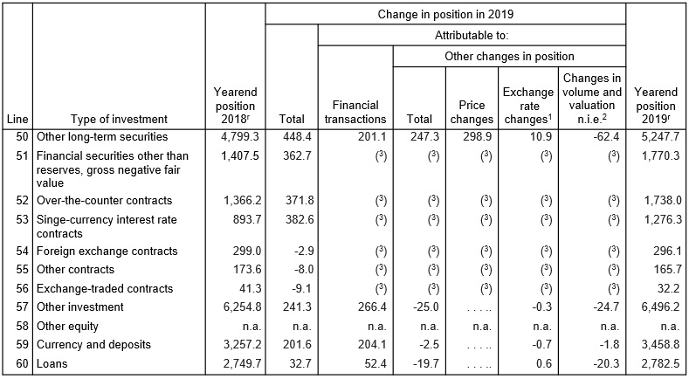
Table 13.3 Change in the Yearend U.S. Net International Investment Position (Billions of Dollars) (6 of 8)
Notes:
Continuation of the table. The columns have the following headings from left to right. Line, Type of investment, Yearend position 20 18 super r, Change in position in 20 19, total, Change in position in 20 19, attributable to, financial transactions, Change in position in 20 19, attributable to, other changes in position, total, Change in position in 20 19, attributable to, other changes in position, price changes, Change in position in 20 19, attributable to, other changes in position, exchange rate changes super 1 , Change in position in 20 19, attributable to, other changes in position, changes in volume and valuation n i e super 2, Yearend position, 20 19 super r. The row entries are as follows. Row 1. 50, Other long term securities, 4799.3, 448.4, 201.1, 247.3, 298.9, 10.9, Negative 62.4, 5247.7. Row 2. 51, Financial securities other than reserves, gross negative fair value, 1407.5, 362.7, Left parenthesis 3 right parenthesis Left parenthesis 3 right parenthesis Left parenthesis 3 right parenthesis Left parenthesis 3 right parenthesis Left parenthesis 3 right parenthesis 1,770.3. Row 3. 52, Over the counter contracts, 1366.2, 371.8, Left parenthesis 3 right parenthesis Left parenthesis 3 right parenthesis Left parenthesis 3 right parenthesis Left parenthesis 3 right parenthesis Left parenthesis 3 right parenthesis 1,738.0. Row 4. 53, Singe currency interest rate contracts, 893.7, 382.6, Left parenthesis 3 right parenthesis Left parenthesis 3 right parenthesis Left parenthesis 3 right parenthesis Left parenthesis 3 right parenthesis Left parenthesis 3 right parenthesis 1,276.3. Row 5. 54, Foreign exchange contracts, 299, Negative 2.9, Left parenthesis 3 right parenthesis Left parenthesis 3 right parenthesis Left parenthesis 3 right parenthesis Left parenthesis 3 right parenthesis Left parenthesis 3 right parenthesis 296.1. Row 6. 55, Other contracts, 173.6, Negative 8.0, Left parenthesis 3 right parenthesis Left parenthesis 3 right parenthesis Left parenthesis 3 right parenthesis Left parenthesis 3 right parenthesis Left parenthesis 3 right parenthesis 165.7. Row 7. 56, Exchange traded contracts, 41.3, Negative 9.1, Left parenthesis 3 right parenthesis Left parenthesis 3 right parenthesis Left parenthesis 3 right parenthesis Left parenthesis 3 right parenthesis Left parenthesis 3 right parenthesis 32.2. Row 8. 57, Other investment, 6254.8, 241.3, 266.4, Negative 25.0, Nil, Negative 0.3, Negative 24.7, 6,496.2. Row 9. 58, Other equity, N A, N A, N A, N A, N A, N A, N A, N A. Row 10. 59, Currency and deposits, 3257.2, 201.6, 204.1, Negative 2.5, Nil, Negative 0.7, Negative 1.8, 3,458.8. Row 11. 60, Loans, 2,749.7, 32.7, 52.4, Negative 19.7, Nil, 0.6, Negative 20.3, 2,782.5. Continued.

Slide 46
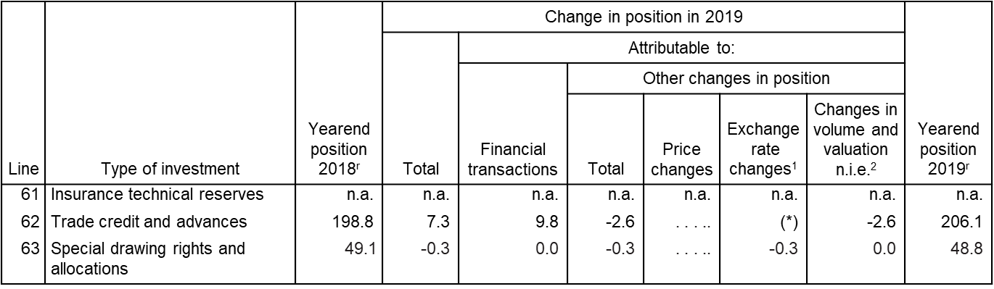
Table 13.3 Change in the Yearend U.S. Net International Investment Position (Billions of Dollars) (7 of 8)
r Revised; n.a. Not available. . . . Not applicable
Value between zero and
Represents gains or losses on foreign-currency-denominated assets and liabilities due to their revaluation at current exchange rates.
Notes:
Continuation of the table. The columns have the following headings from left to right. Line, Type of investment, Yearend position 20 18 super r, Change in position in 20 19, total, Change in position in 20 19, attributable to, financial transactions, Change in position in 20 19, attributable to, other changes in position, total, Change in position in 20 19, attributable to, other changes in position, price changes, Change in position in 20 19, attributable to, other changes in position, exchange rate changes super 1 , Change in position in 20 19, attributable to, other changes in position, changes in volume and valuation n i e super 2, Yearend position, 20 19 super r. The row entries are as follows. Row 1. 61, Insurance technical reserves, N A, N A, N A, N A, N A, N A, N A, N A. Row 2. 62, Trade credit and advances, 198.8, 7.3, 9.8, Negative 2.6, Nil, Left parenthesis asterisk right parenthesis, Negative 2.6, 206.1. Row 3. 63, Special drawing rights and allocations, 49.1, Negative 0.3, 0.0, Negative 0.3, Nil, Negative 0.3, 0.0, 48.8.

Slide 47
Table 13.3 Change in the Yearend U.S. Net International Investment Position (Billions of Dollars) (8 of 8)
Includes changes due to year-to-year shifts in the composition of reporting panels and to the incorporation of more comprehensive survey results. Also includes capital gains and losses of direct investment affiliates and changes in positions that cannot be allocated to financial transactions, price changes, or exchange-rate changes.
Financial transactions and other changes in financial derivatives positions are available only on a net basis, which is shown on line 3; they are not separately available for gross positive fair values and gross negative fair values of financial derivatives.
Data are not separately available for price changes, exchange-rate changes, and changes in volume and valuation not included elsewhere.
Note: Details may not add to totals because of rounding.
Source: U.S. Bureau of Economic Analysis, June 20, 2020.

Slide 48
Summary (1 of 3)
A country’s G N P is roughly equal to the income received by its factors of production.
In an open economy, G N P equals the sum of consumption, investment, government purchases, and the current account.
G D P is equal to G N P minus net income from foreign countries for factors of production. It measures the value of output produced within a country’s borders.

Slide 49
Summary (2 of 3)
National saving minus domestic investment equals the
current account
The current account equals the country’s net foreign investment (net outflows of financial assets).
The balance of payments accounts records flows of goods and services and flows of financial assets across countries.
It has three parts: current account, capital account, and financial account, which balance each other.
Transactions of goods and services appear in the current account; transactions of financial assets appear in the financial account.

Slide 50
Summary (3 of 3)
Official international reserve assets are a component of the financial account, which records official assets held by central banks.
The official settlements balance is the negative value of official international reserve assets, and it shows a central bank’s holdings of foreign assets relative to foreign central banks’ holdings of domestic assets.
The United States is the largest debtor nation, and its foreign debt continues to grow because its current account continues to be negative.

Slide 51

Copyright
This work is protected by United States copyright laws and is provided solely for the use of instructors in teaching their courses and assessing student learning. Dissemination or sale of any part of this work (including on the World Wide Web) will destroy the integrity of the work and is not permitted. The work and materials from it should never be made available to students except by instructors using the accompanying text in their classes. All recipients of this work are expected to abide by these restrictions and to honor the intended pedagogical purposes and the needs of other instructors who rely on these materials.

